Slide 1
STORY OF AZURE
The Beginning

Slide 2


Slide 3
RULES BEFORE START

Slide 4


Slide 5
Cloud Computing Introduction

Slide 6
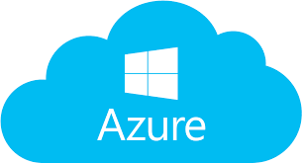
MICROSOFT AZURE CLOUD

Slide 7
The name cloud computing was inspired by the cloud symbol that's often used to represent the internet in flowcharts and diagrams.

Slide 8
Cloud Computing
cloud computing means storing and accessing data over the internet instead of a hard disk. It is defined as a service that provides users to work over the internet. Users can access data on the Cloud and must provide a user ID and password to gain entry, for security reasons.

Slide 9
Already using cloud computing right now, even if you don’t realise it. If you use an online service like GMAIL for example to send emails, edit documents using Google docs, or stream music or films online, it’s likely that, cloud computing is making it all possible behind the scenes.

Slide 10
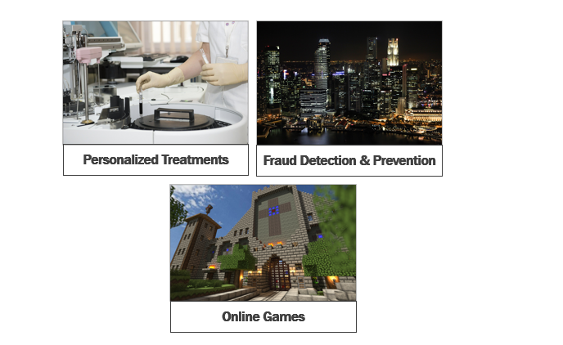

Slide 11
FlashBack Story

Slide 12
As far as an application for a business is concerned, there are 2 main aspects.
Desiging and developing the business application itself, and then
Hosting this application on a server to make it available for business.

Slide 13
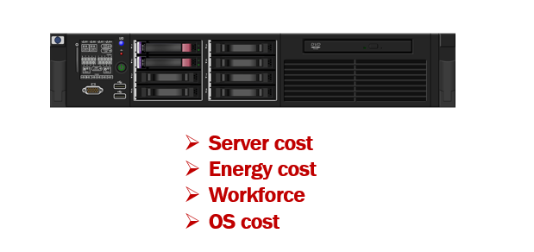

Slide 14
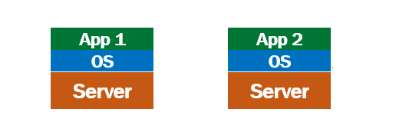

Slide 15
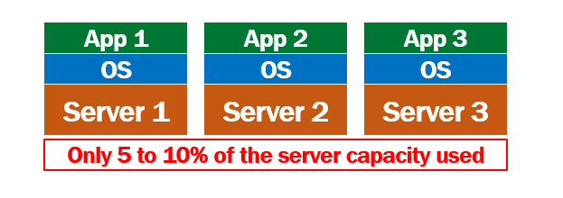

Slide 16
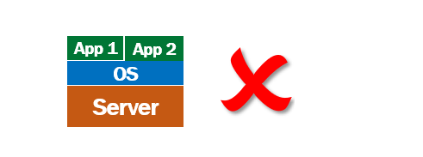

Slide 17
there is a one to one mapping between an application and a physical server.

Slide 18
Virtual Machines

Slide 19
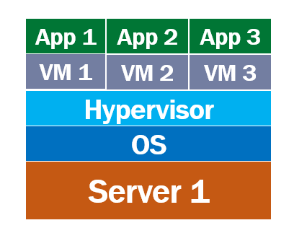

Slide 20
On top of the physical server, we have the operating system installed. This is the host operating system i.e operating system at the physical server level. On top of that we install a piece of software called Hypervisor. Hypervisor is a technology from VMware that virtualises the hardware of the physical server. On top of this we create a virtual machine. In fact, we can create and run multiple virtual machines on a single physical server. My first application runs on VM1 and the second application runs on VM2. If I have a thrid application, I simply spin up a new VM and then safely and securely run it from the third VM. This is brilliant, because we are now able to make proper use of the server hardware.

Slide 21
a virtual machine virtualises the hardware of the physical server. This means each virtual machine that is created, gets a slice of the the server hardware. In our case we created 4 virtual machines, so each VM gets 25% of memory, disk space, processor and other server hardware resources.

Slide 22
Containers

Slide 23
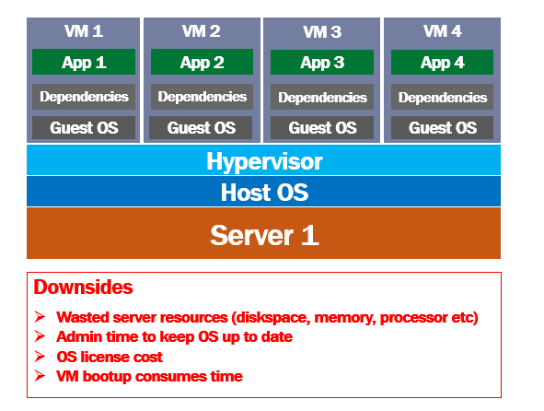

Slide 24
What are containers
A virtual machine virtualises the server hardware where as containers virtualises the operating system, i.e it's an abstraction at the operating system level. Multiple containers can run on the same machine and share the host operating system kernel. Unlike a VM, a container does not required it's own operating system. Straight away you can see the amount of disk space, ram and processor time that is saved.

Slide 25
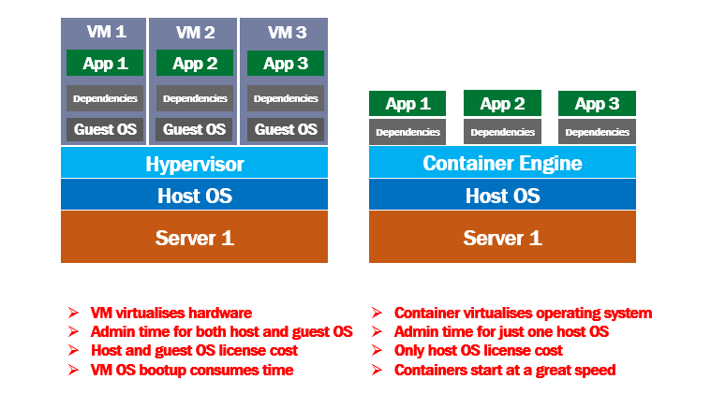

Slide 26
BENEFITS OF CLOUD

Slide 27
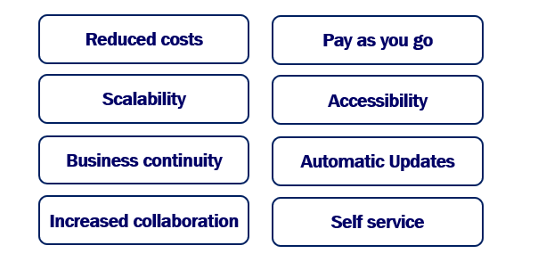

Slide 28
RISKS OF CLOUDS

Slide 29
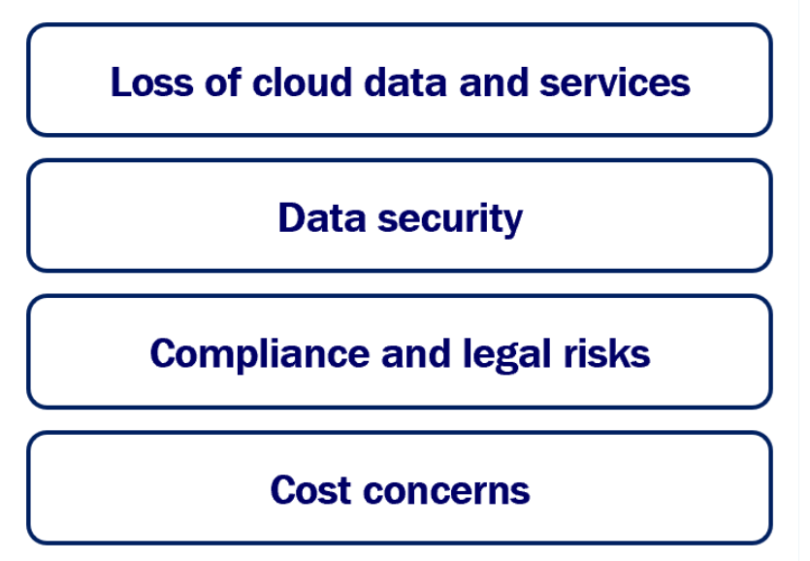

Slide 30
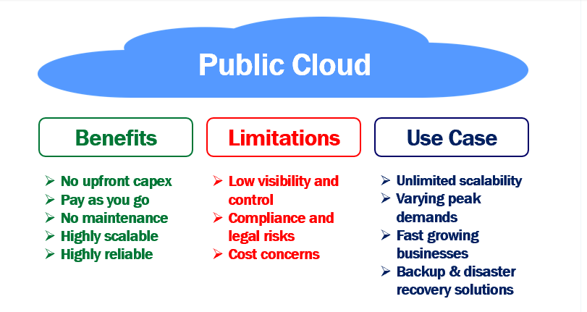

Slide 31
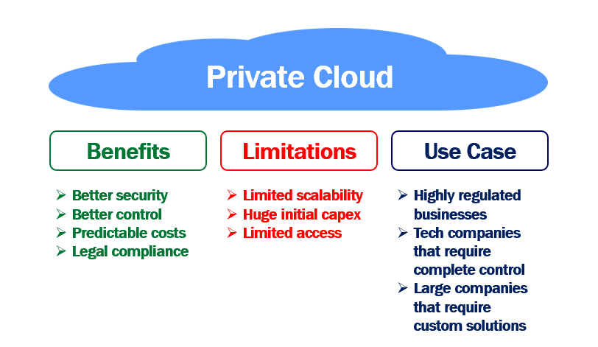

Slide 32
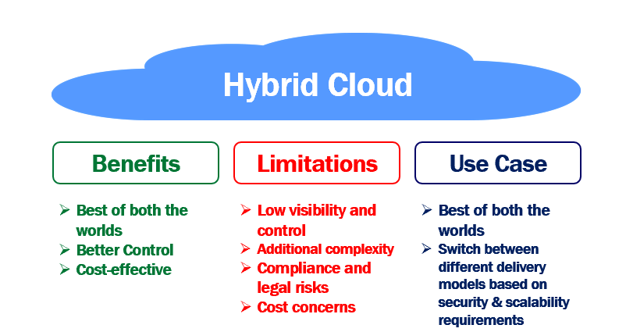

Slide 33
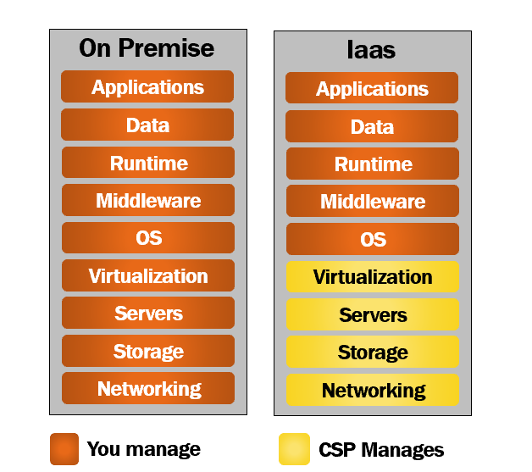
As the name implies, with Infrastructure as a Service, you rent or lease IT infrastructure from a cloud service provider like Microsoft Azure, Amazon Web Services or some other cloud provider.

Slide 34
IaaS
In most organisations, it is the Infrastructure team that procures servers, and computers. Install software and provide systems to employees. Set up and manage networks. So in most cases, it is usually your infrastructure team that uses Infrastructure as a Service (IaaS). Sometimes, even software developments teams use this service if they want to have enhanced control over the underlying hardware and network.

Slide 35
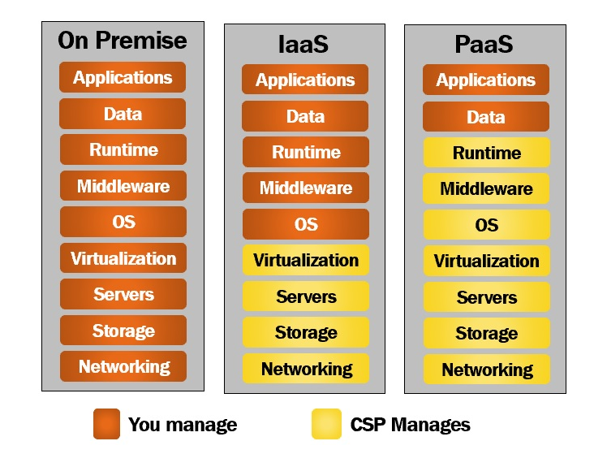

Slide 36
PaaS
Well, it is primarily used by software development teams. As the name implies, it provides the platform for developing software applications. It is a complete development and deployment environment in the cloud. It enables you to deliver everything from simple cloud-based apps to sophisticated, enterprise class cloud-enabled apps.
For example, let's say you want to develop data driven web applications. For this, we need a framework like ASP.NET Core or Java. To store data we need a database like SQL Server or Oracle for example. We need a web server to host and run a web application. Purchasing all these softwares, installing, setting up the development environment and maintaining it, is not only expensive but also time consuming.
With Platform as a Service, the cloud service provider, provides all these softwares, installs and configures them. You have the development platform available with a few clicks in just a few minutes. You pay for the service on a pay-as-you-go basis and access it over a secure Internet connection. When you no longer need the service, you shut things down and stop paying.
Windows Azure, AWS Elastic Beanstalk, and Google App Engine are few examples of Platform as a Service.

Slide 37
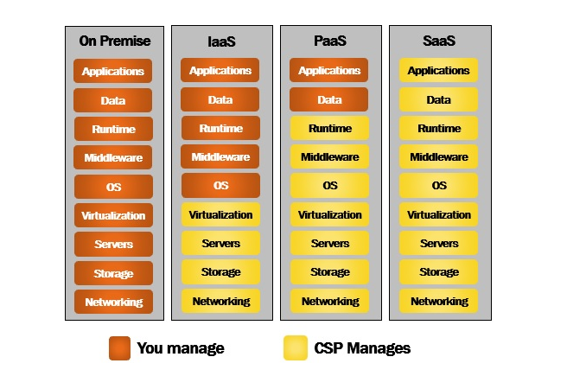

Slide 38
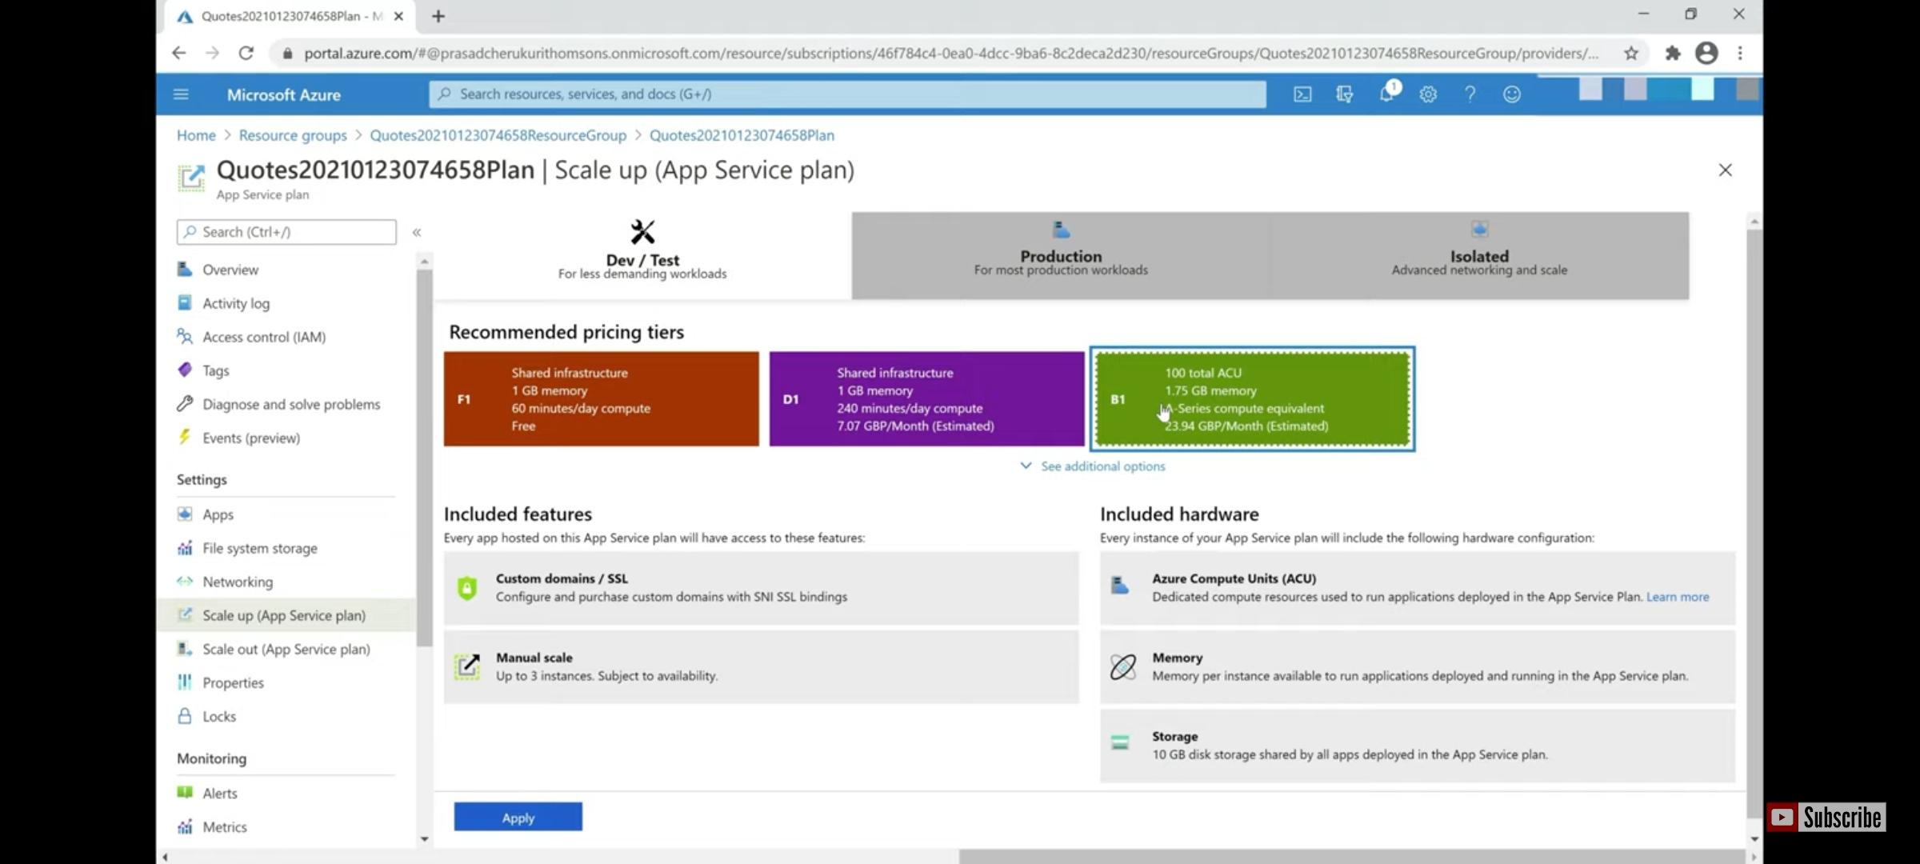

Slide 39
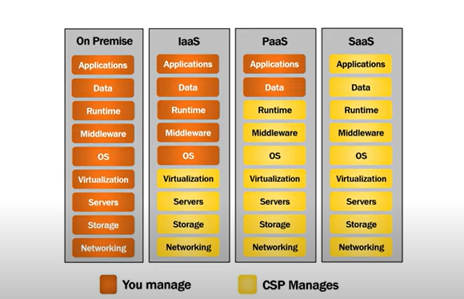

Slide 40
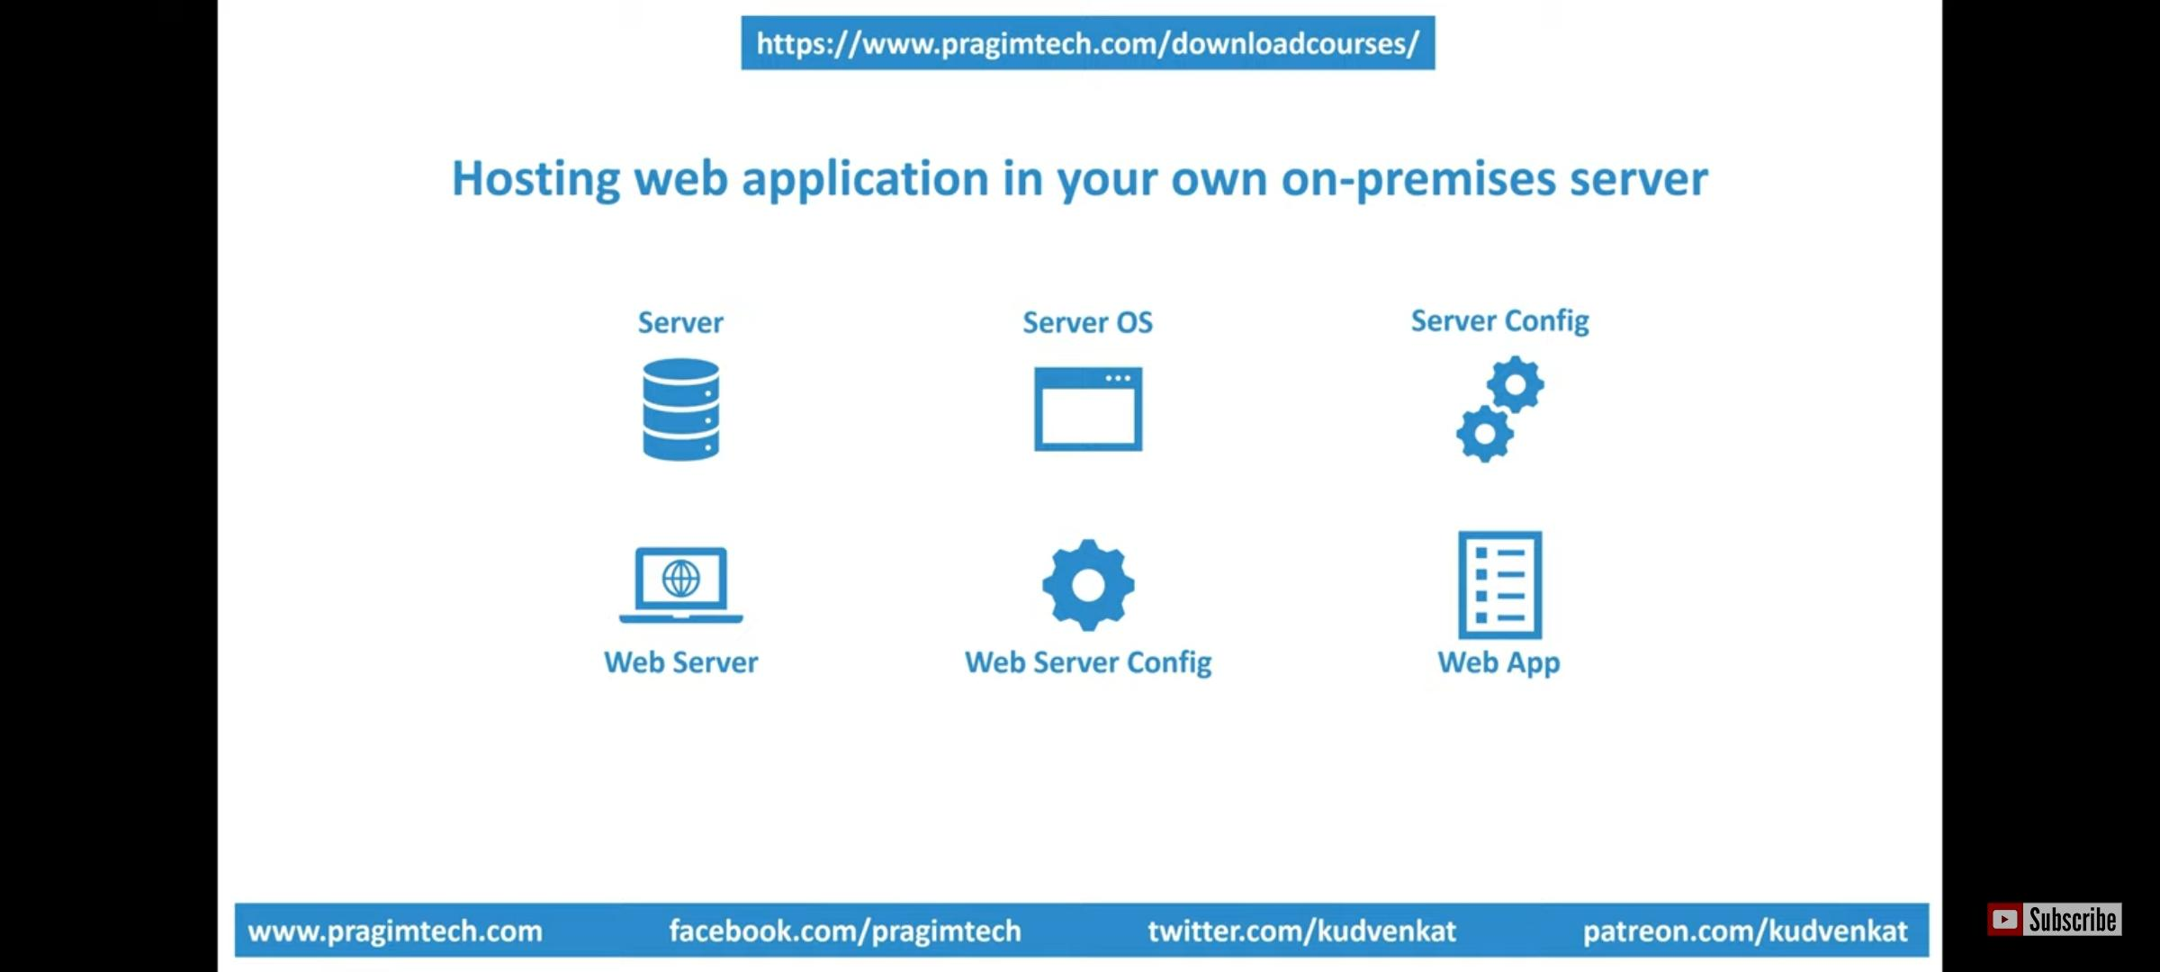

Slide 41
Thank You

